Slide 1


Illumina Assembly

Slide 2
Outline
The types of Illumina data
Methods of assembly
Repeats
Selecting k-mer size
Assembly Tools
Assembly Diagnostics
Assembly Polishing

Slide 3
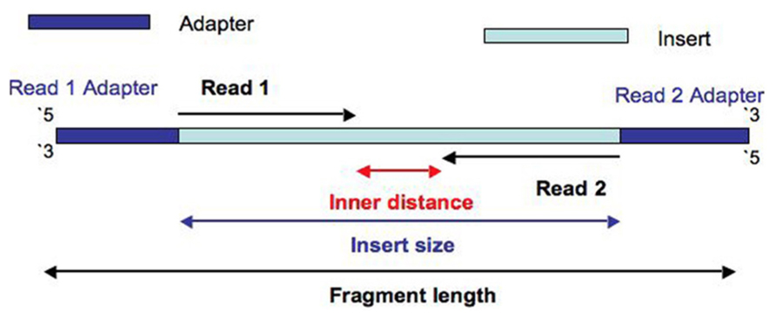
Illumina Sequencing
Paired end Illumina library

Slide 4
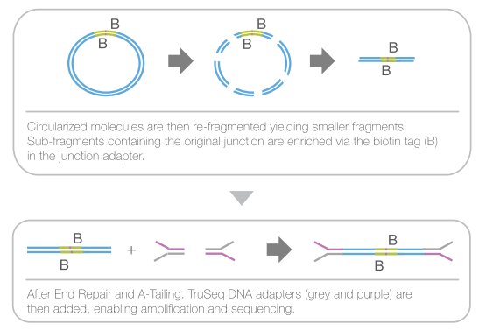
Illumina Sequencing
Mate pair Illumina library

Slide 5
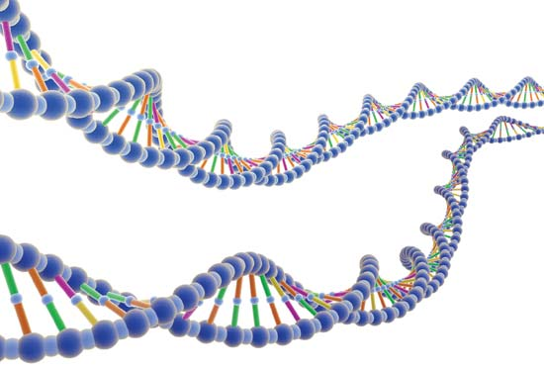
Methods of assembly
Shear and sequence the DNA.
Find overlaps in the reads and construct an assembly graph
Simply the assembly graph

Slide 6
Methods of assembly
Used for first generation reads (e.g. Sanger)
Overlap - Layout - Consensus
Overlap
All vs all pair-wise read comparison
Build graph; nodes = reads, edges = overlaps
Layout
Analyze, simplify, and clean the overlap graph
Determine a Hamiltonian path through the graph ( visit each node only once, can ignore edges )
Consensus
Align reads to the assembly path
Call bases using weighted voting

Slide 7
Methods of assembly
Short reads too numerous for OLC
De Bruijn graph
Break all reads into k-mers. A read has L-k+1 k-mers.
Construct graph
Nodes = distinct k-mer
Edges = k-1 exact overlap between two nodes.
Simplify the graph
Remove bubbles, tips, and poorly supported edges.
Find Eulerian path through the graph ( Every edge visited once - faster than finding Hamiltonian path )
ACGTTAGT
ACGTTA -> CGTTAG -> GTTAGT

Slide 8
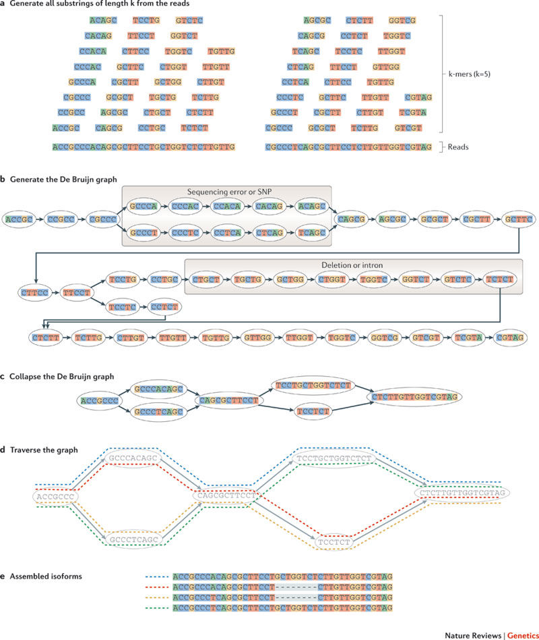
Methods of assembly

Slide 9
Methods of assembly
Martin and Wang 2011

Slide 10
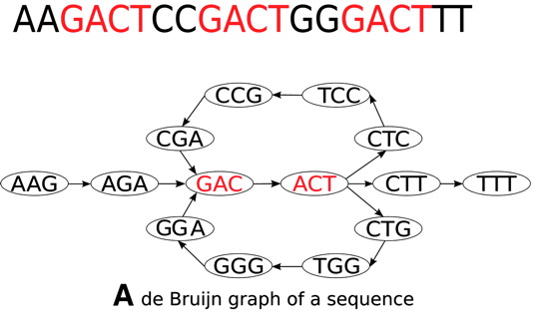
Repeats
The biggest problem for short read assembly are repeats.

Slide 11
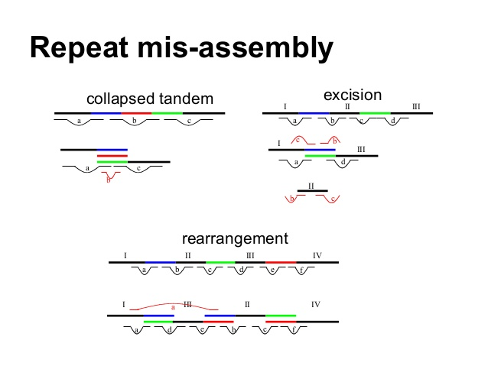
Repeats

Slide 12
Repeats

Slide 13
Repeats

Slide 14
Selecting k-mer size
De Bruijn Graph simplification is highly affected by your choice of k-mer size.
Some tools explore multiple k-mer sizes
Others only use one k-mer size.
Small k-mer sizes result in lots of connections.
Large k-mer sizes help resolve complex regions
If the k-mer size is larger than the repeat, the repeat can be anchored in unique sequence on both sides.
Errors mean connections between k-mers may be lost.
Size selection can by guided by tools like K-mer Genie
Best k depends entirely on the properties of your genome and the error rate in the reads.

Slide 15
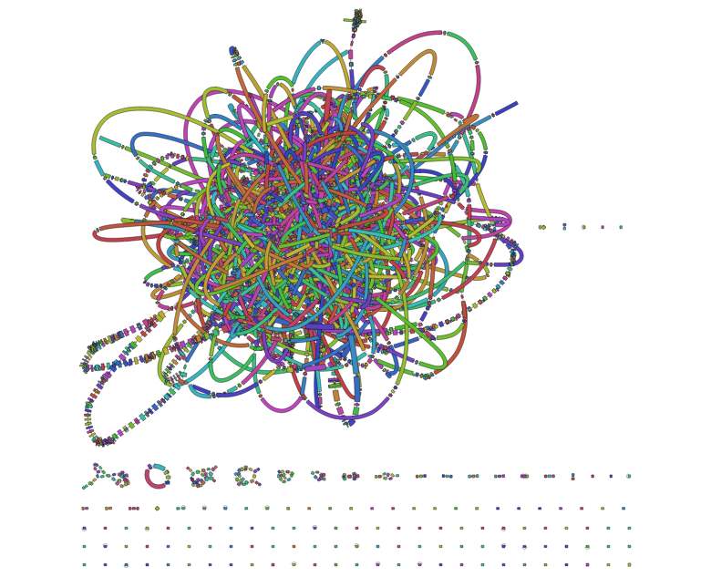
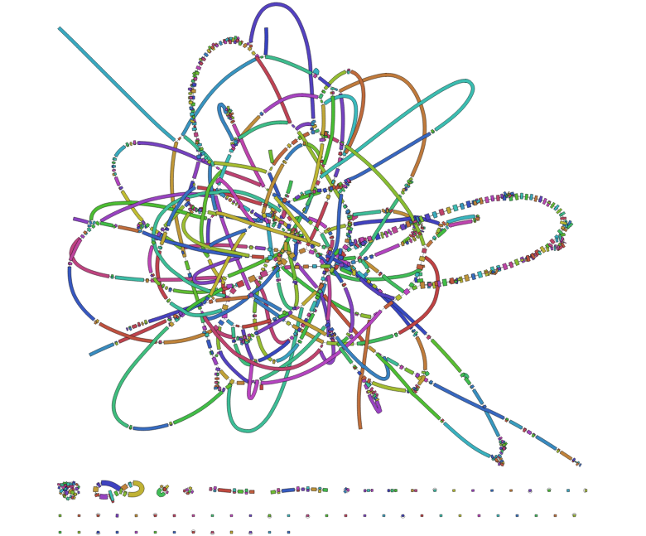
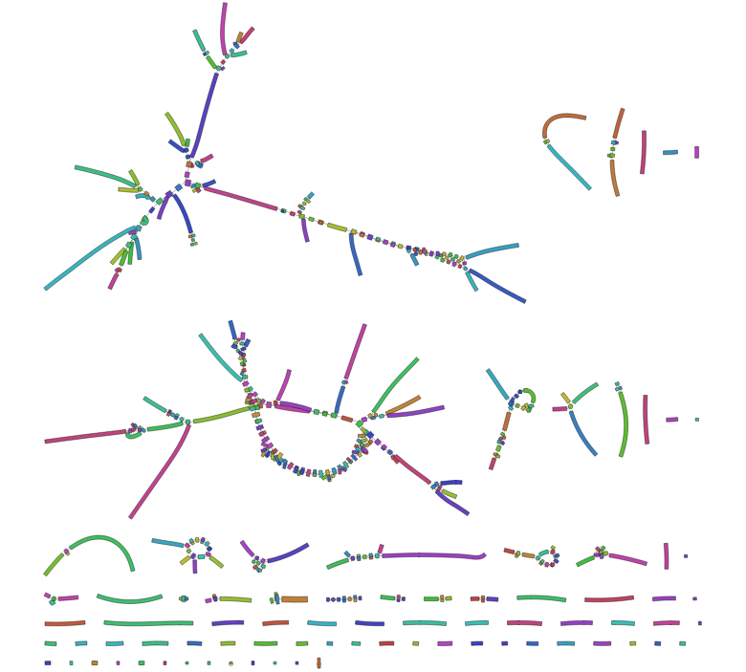
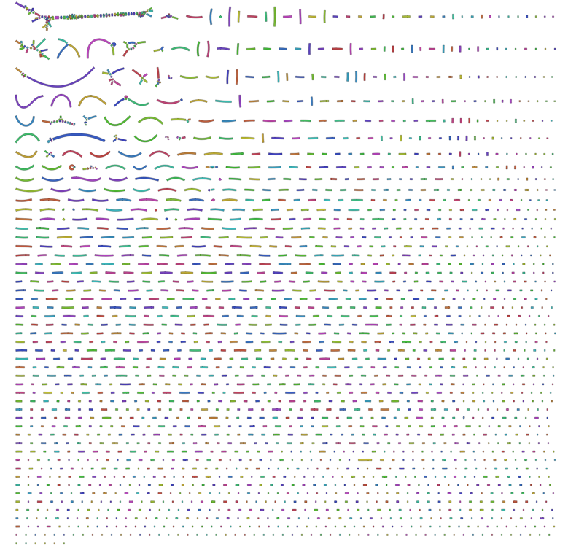
Selecting k-mer size
R. Wick. Effect of k-mer size
k = 51
k = 61
k = 81
k = 91

Slide 16
Assembly Tools
Many short read assemblers available
Spades
Often produces the best assembly for small genomes.
Explores multiple k-mer sizes and merges results.
Handles single cell, plasmid, and meta-genome assembly too.
Can use long reads in scaffolding.
AllPaths-LG
Suitable for large genomes
Requires specific Illumina libraries
MaSuRCA
Suitable for very large genomes
Sometimes over-assembles
Abyss
Suitable for very large genomes
Soap de novo
Suitable for large genomes

Slide 17
Assembly Tools
Honorable mentions
Discovar - requires specialized overlapping PCR-free Illumina libraries
Velvet - Formerly popular bacterial assembler
SGA - Experimental string graph assembler
Mira - Flexible assembler for many different platforms
Platanus - Assembler that claims to work with high heterozygosity
CLC Workbench (not free like some others) - often performs well in comparative assessments
And many more …

Slide 18
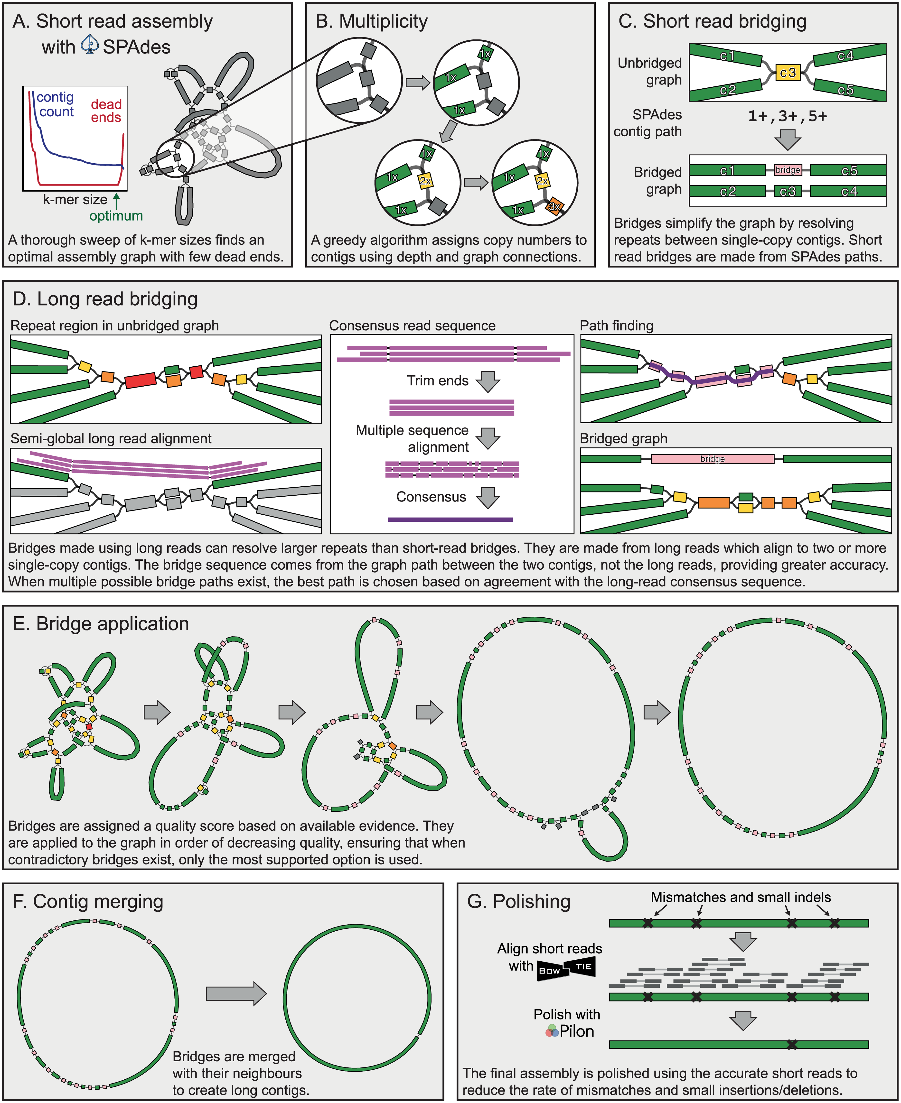
Assembly Tools - Unicycler

Slide 19
Assembly Tools - Unicycler

Slide 20
Assembly Tools
Error correction is often a primary stage in many assemblers
Assemblers:
Spades
Allpaths
MaSuRCA
Datasets for these assemblers should not be filtered (except adapter trimmed)
Stand alone short read error correction tools
Quake
Reptile
QuorUM
LoRMA
Hammer
…

Slide 21
Preliminary Assembly Diagnostics
Assembly Size
Assemblathon Script (https://github.com/KorfLab/Assemblathon)
Quast
Number of scaffolds 556
Total size of scaffolds 31318563
Longest scaffold 447934
Shortest scaffold 8580
Number of scaffolds > 1K nt 556 100.0%
Number of scaffolds > 10K nt 555 99.8%
Number of scaffolds > 100K nt 38 6.8%
Number of scaffolds > 1M nt 0 0.0%
Number of scaffolds > 10M nt 0 0.0%
Mean scaffold size 56328
Median scaffold size 43995
N50 scaffold length 60037
L50 scaffold count 152
Expected genome size

Slide 22
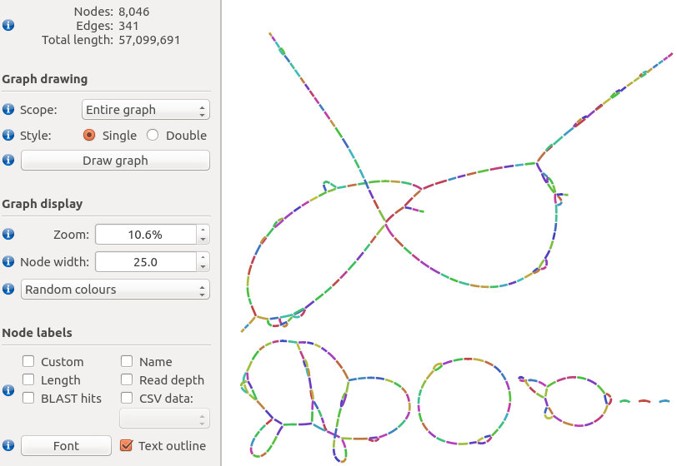
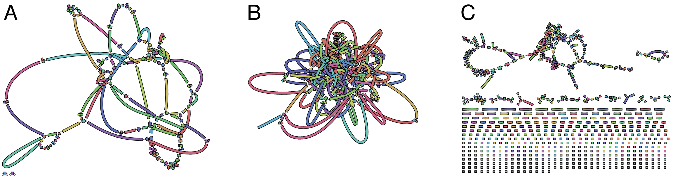
Preliminary Assembly Diagnostics
Assembly Graph
Check connectedness of contigs
Bandage
Created from GFA output
Not supported by all assemblers
Good
OK
Bad

Slide 23
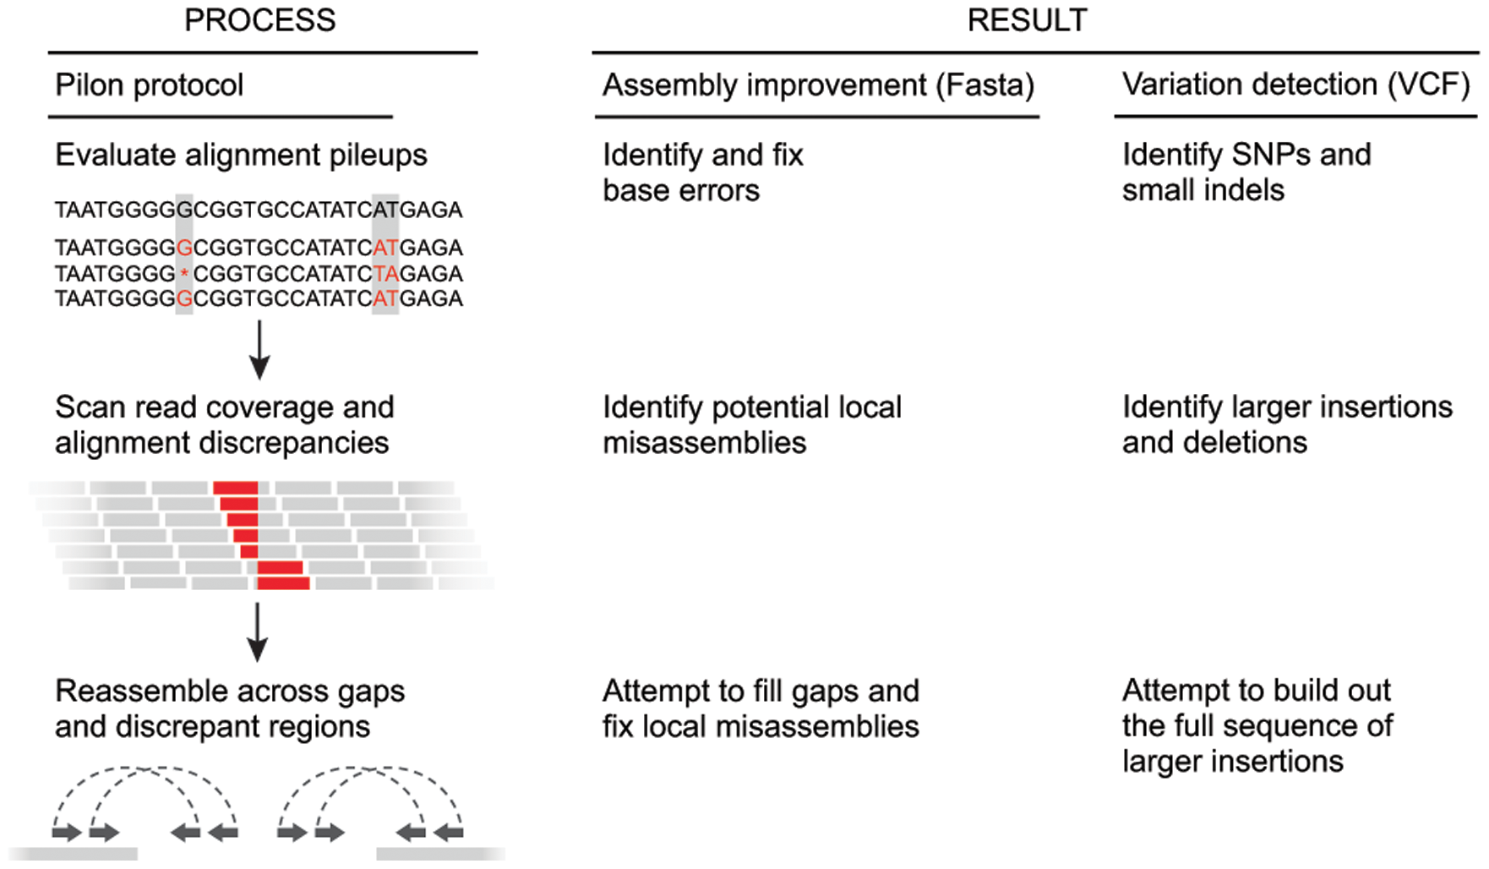
Assembly Polishing

Slide 24
Summary
Check whether your reads need pre-processing or if the assembler does it.
Use a variety of assemblers (and settings).
Some assemblers handle certain properties in genomes better than others.
Explore multiple values of k-mer size for de Bruijn graph assemblers.
Check the basic assembly statistics.
Check assembly graph properties if you can.
Select your best assemblies.
Polish your assemblies
Assess correctness.

